Slide 1
The Use of Aspect-Based Sentiment Analysis on Political Classification & Potential Impacts
HON 451
Hunter Berry

Slide 2
Introduction & Background
Subtitle

Slide 3
“Americans were more ideologically divided than any of the 19 other publics surveyed… These fissures have pervaded nearly every aspect of public and policy response…” -Michael Dimock, President of the Pew Research Center

Slide 4
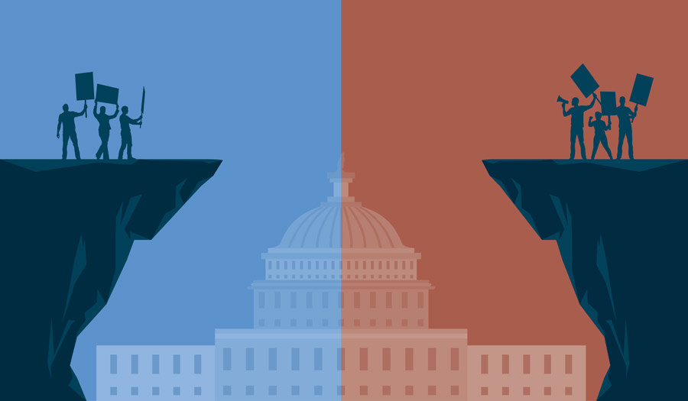
Background
In the United States, political party is one of the most important “classifications” that belong to a person.
We make daily decisions based around party, including where we shop, who we interact with, and how we feel about ongoing public policy.
With a growing partisan divide, we’ve seen many issues in the United States grow more and more violent and discriminatory, using party as the dividing line.
BLM / Defund the Police
Election / Capital Riots
COVID-19 / Coronavirus
Twitter has become one of the “hotspots” for political users, using the platform as:
a source a news,
a source of debate/argumentation, and
a source of propaganda/advertising.

Slide 5

Goals / Overview
With the growing divide in the country and Twitter’s role in this issue, as well as the increasing issues surrounding political polarity in general, I seek to determine if Twitter can be used to identify someone’s political party.
If so, what does this mean for the world, and are the results good or bad?
What can we do to prevent misuse of this technology?
Presentation Outline:
Data Definitions & Literature Review
Methodology & Implementation of Models
Results
Future Work & Complications
Implications
Final Thoughts

Slide 6
Definitions & Literature Review
Subtitle

Slide 7
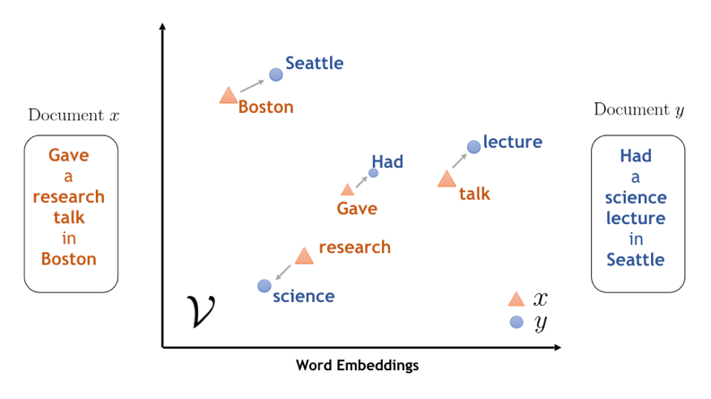
Misc. Terms and Definitions
Features
The data that allows us to make a prediction. Think the “X” or “independent variable.” We have lots of them in our data – things like sentiment towards “national security” or the number of times a user used the word “horrendous.”
Labels
Labels are the things we want to classify. In the case of this study, we have two labels – Republican (R) and Democrat (D).
Vectorization
Mapping words and phrases to vectors of real numbers. Allows for comparison of different words and phrases.
Bag-of-Words
Similar to a frequency table, a bag-of-words is a dataset of words in their simplest form. We count the words used overall and the words used in a specific instance to analyze frequency.

Slide 8
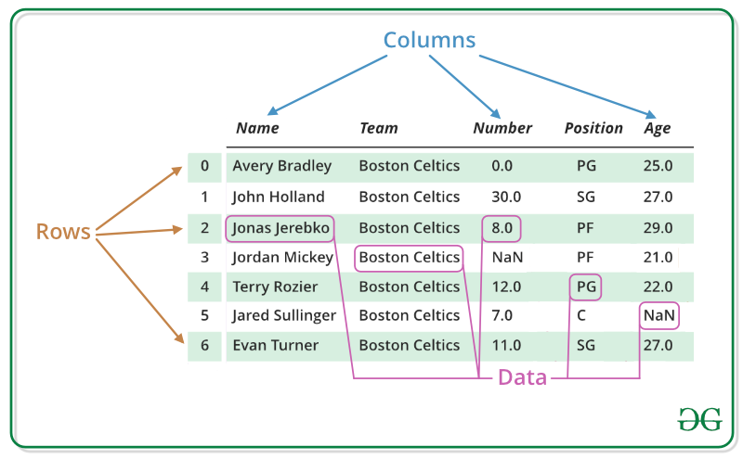
Terms & Definitions Cont.
Supervised Learning
Most common type of method for classification problems. Map input to output labels or map input to a continuous output.
Unsupervised Learning
Unsupervised learning is a type of machine learning where the machine is not given any specific labels and is told to classify and section the data as it sees fit.
DataFrame
Similar to a CSV/Excel spreadsheet. Data is separated into rows and columns, each of which can be filtered and queried.

Slide 9
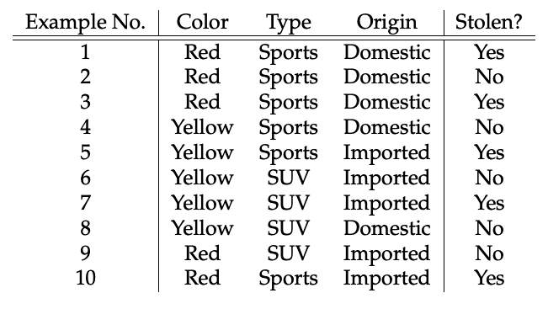

Naïve Bayes Classifier
Naïve Bayes is a probabilistic method of classification.
$\text{P}\text{(}\text{A}\text{|}\text{B}\text{) = }\frac{\text{P}\text{(}\text{B}\text{|}\text{A}\text{)∗}\text{P}\text{(}\text{A}\text{)}}{\text{P}\text{(}\text{B}\text{)}}$
A: Label
B: Feature
Probability of a certain classification being given when provided a set of features.
If someone uses the word “terrorism,” what are the odds they are a Republican given the likelihood of the term occurring in general.
Extremely Successful in Recent Studies
2016 Presidential Election – Short Term Events
~75% Accuracy

Slide 10
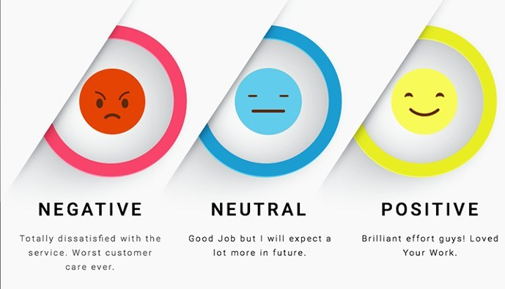
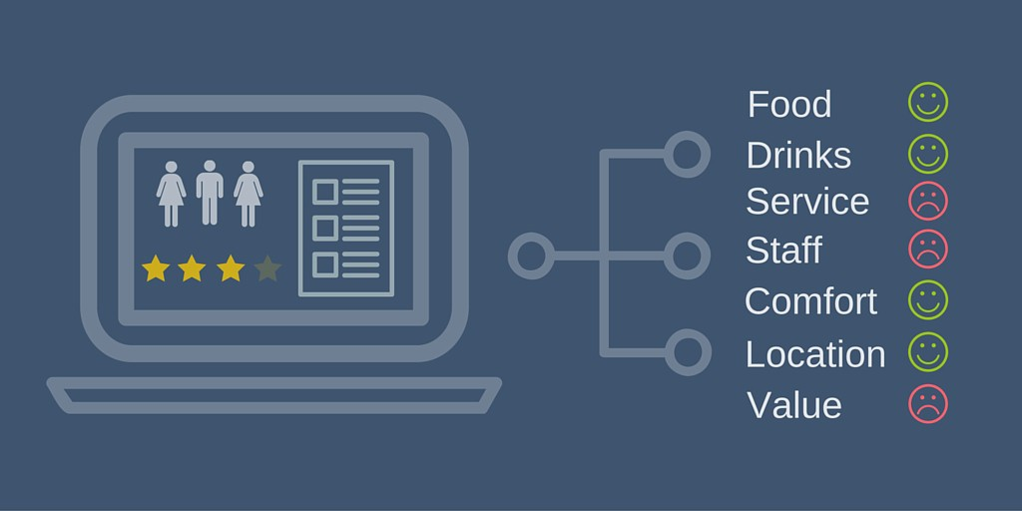
Sentiment Analysis
“Field of study that aims to extract opinions and sentiments from natural language text using computational methods.”
Uses the terms and phrases in each sentence or set of words to determine the “sentiment” or opinion of the given set.
Can be a little simplistic, hence why aspect-based sentiment analysis (ABSA) is often used.
Sentiment towards a specific topic or idea.
Promising Results
2011 Irish Elections – 60% SA Accuracy
Zainuddin Twitter Study – 70% ABSA Accuracy

Slide 11
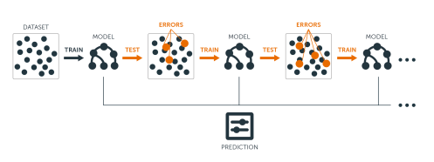
Gradient Boosting Models
Models work on an iterative design process, where each step is an attempt at an improvement on the previous step.
Use errors from model x to adjust the weights of values and calculations in model x + 1.
Process repeats until accuracy no longer improves after weight adjustments.
Top Kaggle Model – XGBoost Regressor
Easy to use, setup, and adjust.
Multi-faceted, can cover a wide variety of areas.

Slide 12
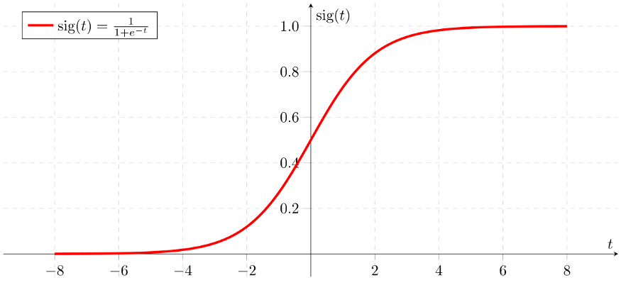
Logistic Regressions
Another type of probabilistic classification.
Similar to Naïve Bayes:
Takes in a number of labels and determines the probability of the label occurring given a number of features.
Use a complex formula to adjust weights and coefficients associated with specific features. Plug in data and get a probability.
Convert this probability into a binary decision to get classification.
Pranckevičius & Marcinkevičius Study
Beat every other tested supervised learning model by at least 10%.
Great results in other ML competitions and studies.

Slide 13
Methods & Implementation

Slide 14
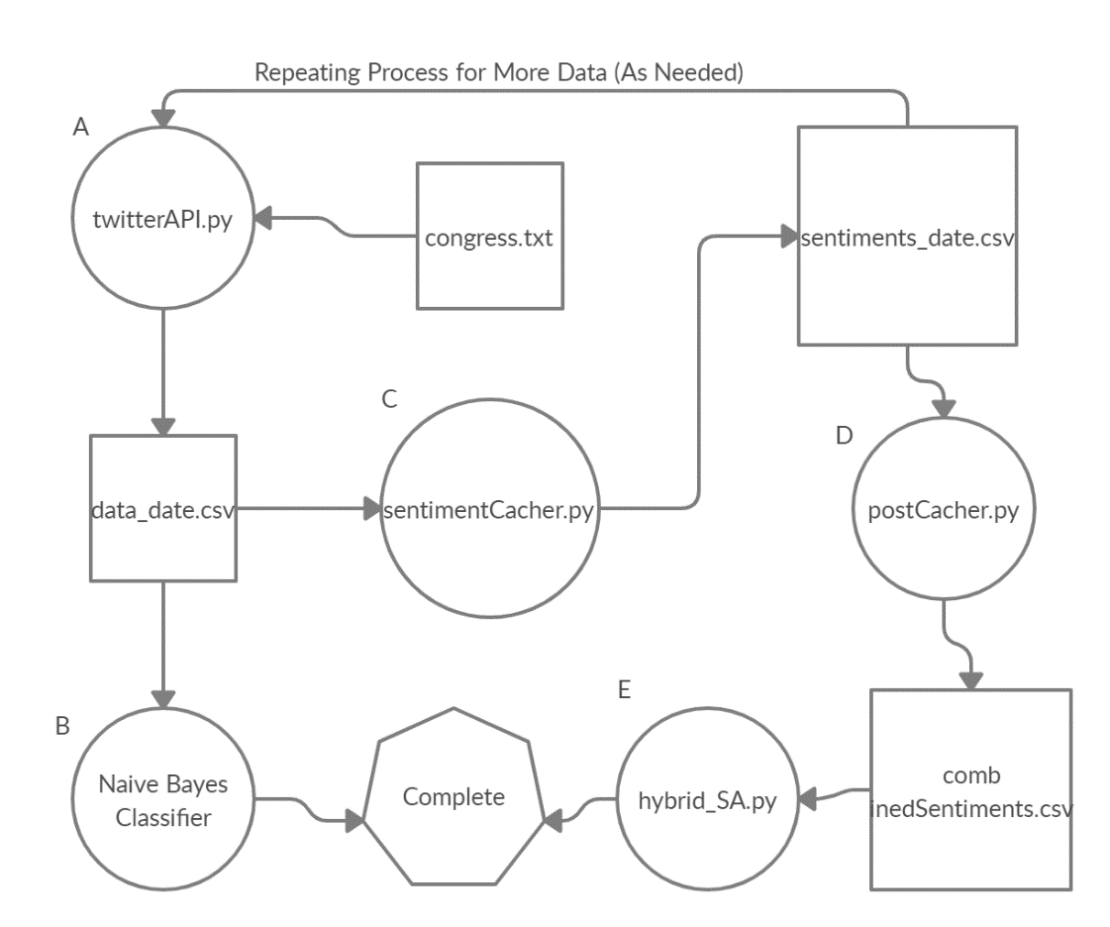
Pipeline Part 1.
Before discussing methodology and implementation of various models, we do a brief discussion on the pipeline.
1st Major Component – twitterAPI.py
Uses an authorized Twitter development account to pull data on ~500 different users.
Congressional figures and other high-level politicians (cabinet members, president, etc.).
Gets five tweets per user, and loads these into a DataFrame and CSV file, both of which can be loaded into other models and files (Naïve Bayes, Hybrid ABSA/ML, etc.).

Slide 15
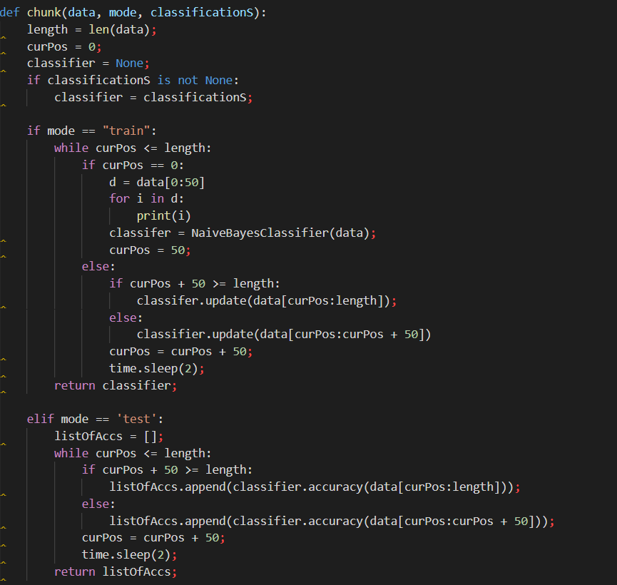

Naïve Bayes
In terms of our specific problem, our model uses an equation:
$P\left(Party | Feature\right)=\frac{P(Feature|Party)∗P(Party)}{P(Feature)}$
Likelihood of a given tweet being of a certain party given any number of features that are associated with the party.
What are the odds of someone being a democrat if they have a negative sentiment towards Donald Trump and a positive sentiment towards healthcare reform?
Implementation
Relies on built in Naïve Bayes modeling tools from the TextBlob Python library, which was used in other studies (Hasan et. al, 2018).
Uses the data from the Twitter API pull results.
Analyzes words usage and sentiments (bag of words and vectorization results) to compute party prediction.

Slide 16
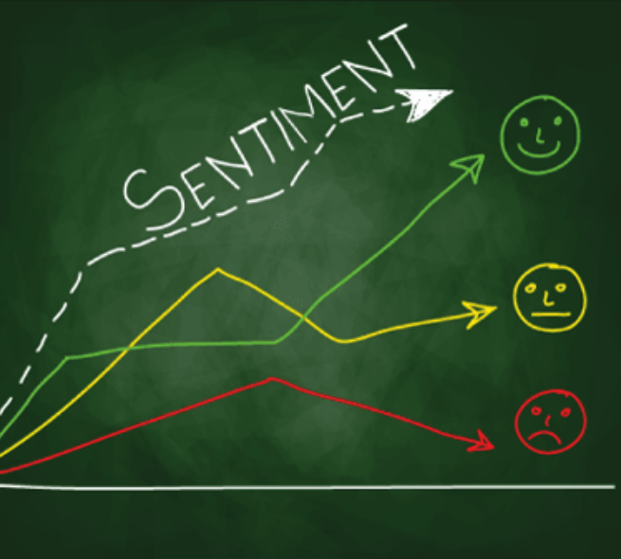
Sentiment Analysis
Goal is to cover as many current events and ongoing political debates as possible.
Key is picking topics that have some easily definable “Republican” or conservative side and “Democratic” or liberal side.
Eight Chosen “Key” Topics
Economics
Police,
Foreign Policy & Immigration
Presidency and Elections
Military
Abortion
Health/Healthcare

Slide 17
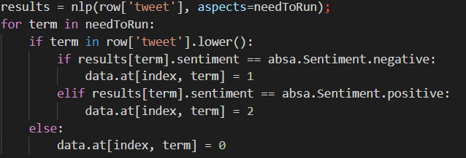
Sentiment Analysis Cont.
Each topic is split into several individual aspects.
In economics, we want to gather sentiment on several ideas – Chinese trade, GDP, the stock market, natural resources, trade, and much more.
Similar for other subjects.
Implementation
We take in data from the Dataframe/CSV produced by the Twitter API file.
Each tweet is parsed and tested on each aspect.
If a tweet contains a word or phrase we test for, we analyze sentiment. If not, we say the tweet is “neutral” towards that specific topic.
Built on library used in previous studies solely for ABSA.
Used a caching system to split parsing process among four computers, dramatically reducing time.

Slide 18
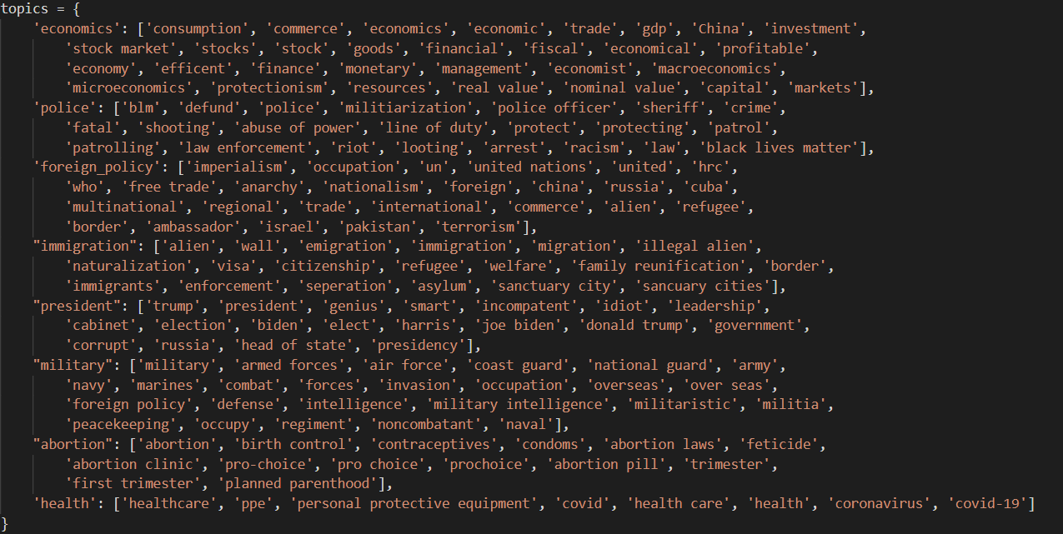

Slide 19
Hybrid Approach (Regressions and Boosting Trees)
Results of sentiment analysis process is piped into a new CSV file, which is in turn used in the “main” hybrid_SA.py file.
Data is loaded in and passed through a vectorizer, with tweets being turned into “bags of words.”
How do the words used in one tweet relate to words used in another tweet? What frequency are terms used in?
These results are concatenated with the data from the sentiment analysis chain and combined into training and testing datasets.
Models loaded from the XGBoost library, which has the “best” tuned XGB Regression model, and Sci-Kit Learn, the most popular and well known Python library for data science.

Slide 20
Results & Thoughts

Slide 21
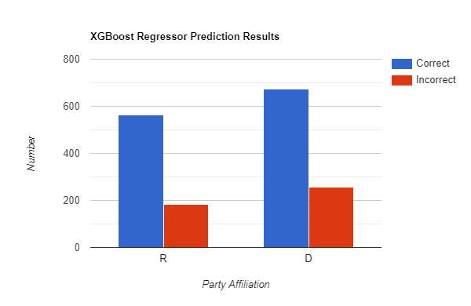
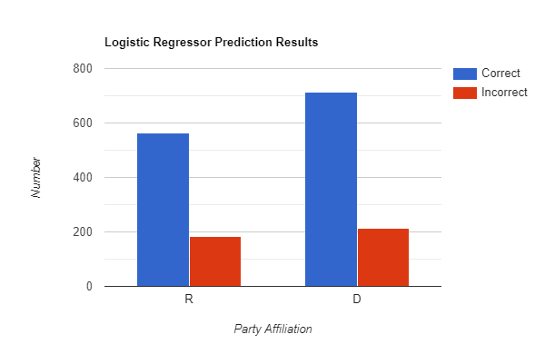
Results
Naïve Bayes
Smaller training and testing dataset than other models, so data and accuracy may be slightly skewed.
~80% accuracy based on tweet text and party alone.
XGBoost Regressor
Larger training dataset by ~3,500 tweets, but slightly smaller (~700) testing dataset.
73.77% Accuracy Level
Extremely slight edge in Republican predictions.
Logistic Regressor
Same datasets as XGBoost model.
76.21% Accuracy Level
Higher accuracy a result of better predictions when looking at Democrats, while both models had similar accuracies for Republicans.

Slide 22

Interface
Created to allow for duplication of results and testing on custom/newer sets of data.
Two “Key” Functions:
Pipeline
Steps through the entire pipeline process, regenerating new tweets from users, conducting sentiment analysis on them, and creating new logistic regressors and boosting models based on this data.
Testing
Allows users to test on “custom” tweets and sentences.
Also allows users to test on Twitter accounts and their five latest tweets.
Allows users to test on the models used in the results section, or use custom models generated through the aforementioned pipeline function.

Slide 24

Limitations
No clear definition on what is “political ideology” and how you determine it.
Liquid vs. Plastic
Policy
How do beliefs coincide with party?
How do we handle people who have beliefs from both sides of the aisle?
Someone who believes in strict capitalism but also wants strong healthcare reform.
Does one belief have more weight in one’s political identification than another?
Is one’s thoughts on abortion worth more than their thoughts on tariffs, or vice versa?

Slide 25

Future Work
Hashtags
Great way of getting data on specific topics/events.
Easy to connect tweets and compare sentiments, words/phrases used, etc.
Language
ABSA couldn’t work on words/phrases that aren’t English.
Trouble with bag-of-words and vectorization comparisons from English to foreign languages.
However, useful in identifying polarity.
Other Models
Unsupervised Learning
Hidden Markov Model (HMM) Chains or Conditional Random Fields (CRFs)

Slide 26
Implications & Ideas

Slide 27
Implications
The Good
The Bad
Reductions in Campaign Spending
2020 U.S. Presidential Election - $14,000,000,000 in Campaign Spending
With this technology, it’s easier to identify Republicans and Democrats, making it easier to advertise to them, thus reducing search costs.
Determining Bots/Fake Users
Typically far-right and far-left users.
Anti-Radicalization & Fake News
Determine common phrases, words, and sentiments, use this to remove/monitor account before they get out of hand.
Discrimination
Stanford “Gaydar” Study
2017 ProPublica Report
Race & Connection to Party
Can easily affect “whether or not individuals get a job, get credit, end up in jail, or even experience violence against them.”
Radicalization
Easy to locate members of a specific party or belief system.
Can be used to gather members to rally.
U.S. Capital Riots

Slide 28

Solutions
Two Main “Goals”:
Increased Data Privacy and
Increased Data Protection
Twitter API Problems
Easy to get access too.
Easy to download massive amounts of data.
No proof of usage.
Solutions
Accounts Set to Default by Private
Protects smaller “ordinary” users, no issues for “content creators” and celebrities.
Limiting Developer Access
Usage Reports
Academia Only
In-House Usage

Slide 29
Thank You For Your Help in this Complex Process!

Slide 30
Questions?

